Slide 1
‘IN THE NAME OF MOST COMPASSIONATE AND MERCIFUL’
TOPIC: CARBON CAPTURE AND STORAGE(CCS)
PRESENTATORS: Alireza Gholami , Mohammad Amin Zamani

Slide 2

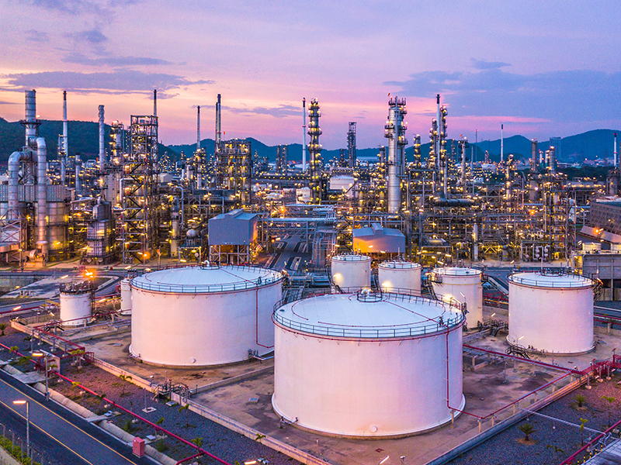
still today most of our primary energy needs are met thanks to fossil fuel which
comprised of coal oil and natural gas yet as well known the burning of fossil fuel release into the atmosphere greenhouse gases which are responsible for the phenomena of global warming and ocean acidification.

Slide 3


in amongst these gases carbon dioxide or co2 is the most dangerous being first by far the quantity released into the atmosphere. Aware of this problem most war nations are actively working towards reducing the co2 emissions and have recently ratified a commitment by sunny the Paris agreement that's committing to reduce emissions to a level that would the theoretically avoid water average temperatures to rise over two degrees Celsius by 2050 compared to pre-industrial level an upper limit that would theoretically avert the worst consequences of climate change.

Slide 4
2018 Fossil fuel share of primary energy demand
Energy efficiency
Renewable energy
81%

Slide 5


2050 Fossil fuel share of primary energy demand
40%

Slide 6
Now how do we solve this problem? the solution is: Carbon Capture And Storage (CCS)

Slide 7
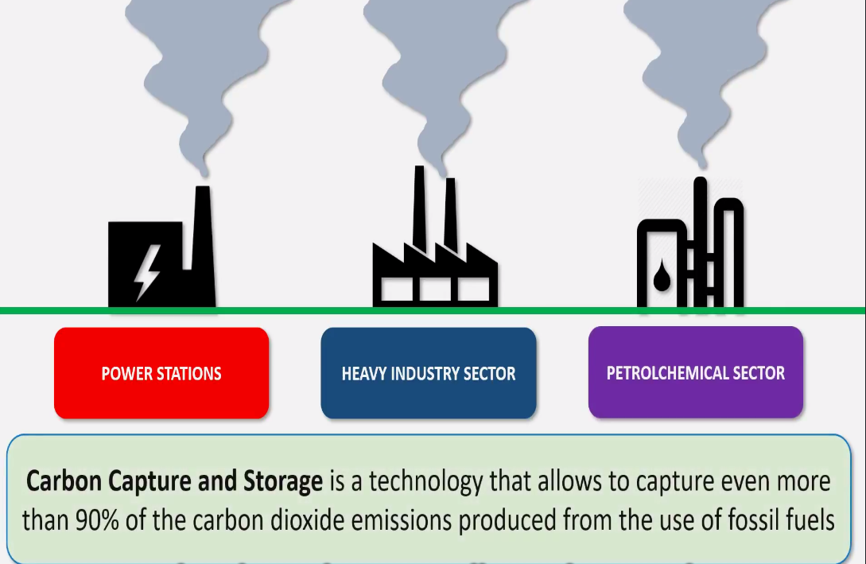
three main sectors

Slide 8
Carbon capture and storage: the process
Phase 1 : ${Co}_{2}$ capture
Phase 1 : 〖𝐶𝑜〗_2 capture
Phase 2 : Transport to storage site
Phase 3 : injection underground

Slide 9
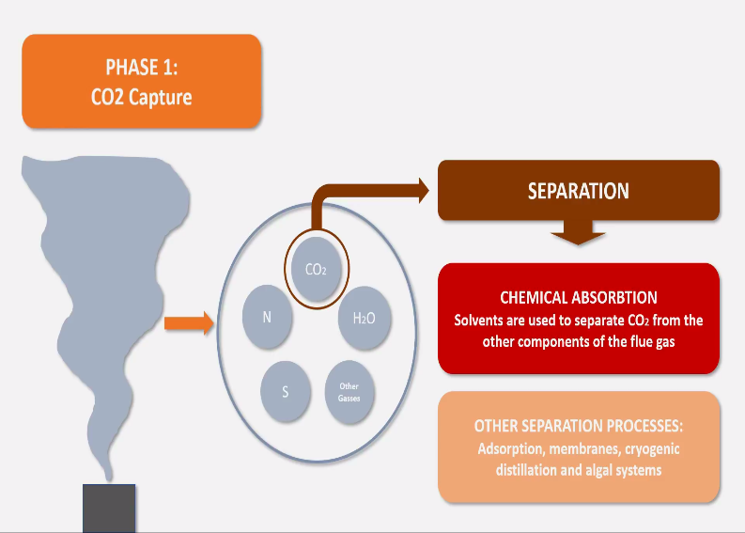

Slide 10

Three main technologies for capturing ${Co}_{2 }$
1.post-combustion
2.pre-combustion
3.oxyfuel-combustion

Slide 11

Post combustion
Capture of ${Co}_{2}$ after the fuel combustion
Can be retrofitted to existing plants
Can be applied to all type of facilities

Slide 12
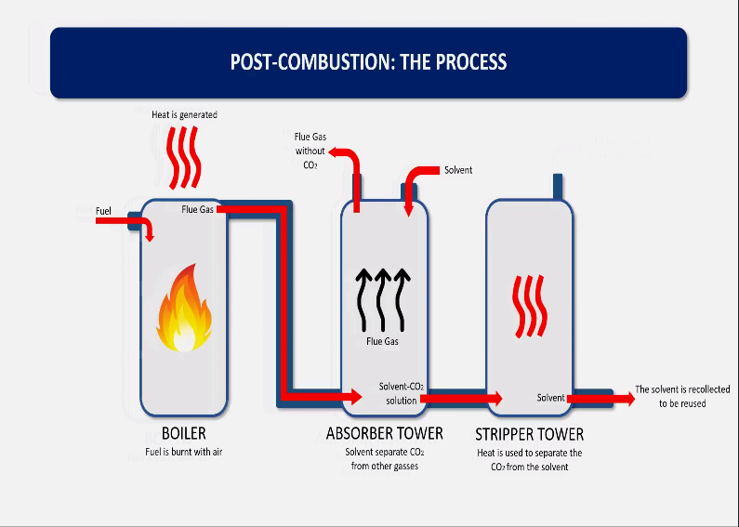

Slide 13


advantages
Disadvantages
Allows to capture about 90% of ${Co}_{2}$
High capital investment
Highest degree of purity in the ${Co}_{2}$captured
Energy penalty : generally higher than 30%
Electricity unit generation cost can be increased by up to 140% in coal-fired plants and 60% in gas-fired plants (Oettinger,2015)
Does not require fundamental changes to the processes of power plants and industrial plants

Slide 14

Pre-combustion
Capture of ${Co}_{2}$before the fuel combustion
Less used than post-combustion
Can only be applied to power plants and a limited type of industrial plants

Slide 15
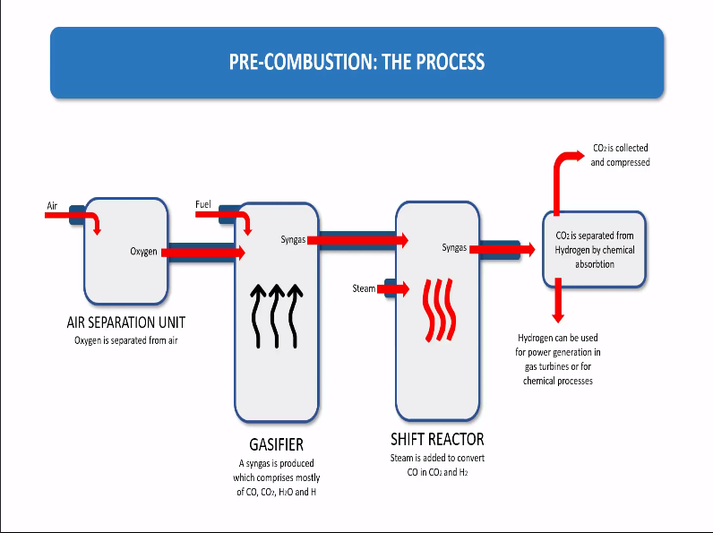

Slide 16

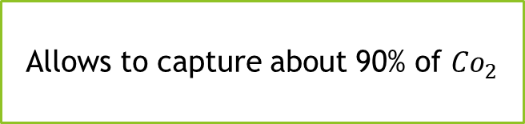
Advantages
Allows to capture about 90% of ${Co}_{2}$
High capital investment
Shift reactor can be omitted to save considerably on initial investment; yet this leads to limited capture efficiency only 18-30% (CATF,2018)
Needs to be built simultaneously with the facility
Cannot be retrofitted to old coal power plants
Energy penalty lower than in post combustion : generally 20%

Slide 17
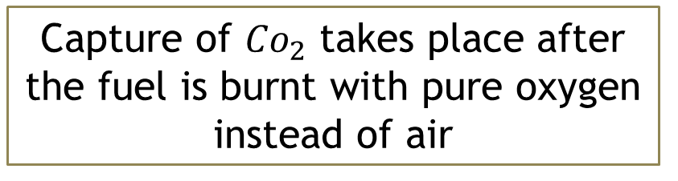
Oxyfuel-combustion
Capture of ${Co}_{2}$ takes place after the fuel is burnt with pure oxygen instead of air
No commercial applications yet
Can be applied to power plants and industrial processes that involve combustion

Slide 18
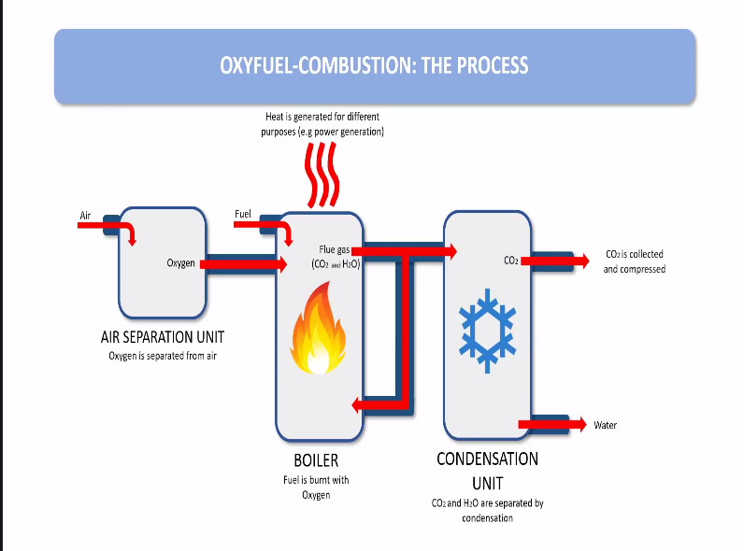

Slide 19


Low emission of nitrogen oxides
Very high capital investment
No need for major chemical processes
Air separation unit very energy intensive
Allows to capture up to 100% of ${Co}_{2}$
Retrofitting to old power plants can be very difficult and expensive

Slide 20
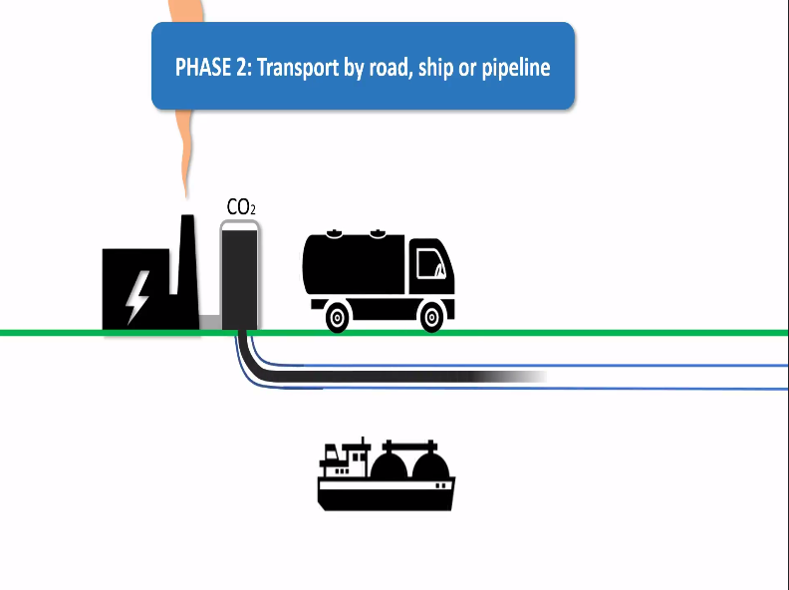

Slide 21
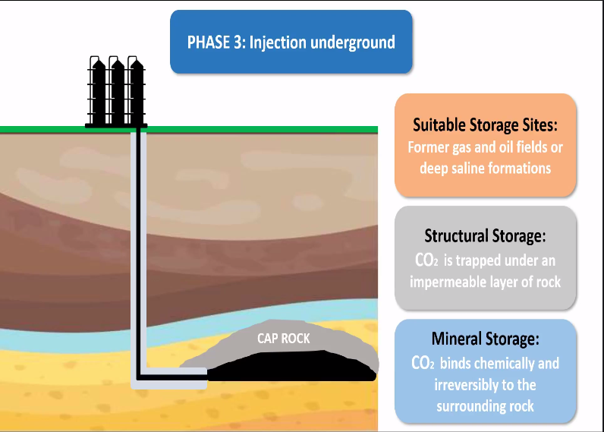

Slide 22
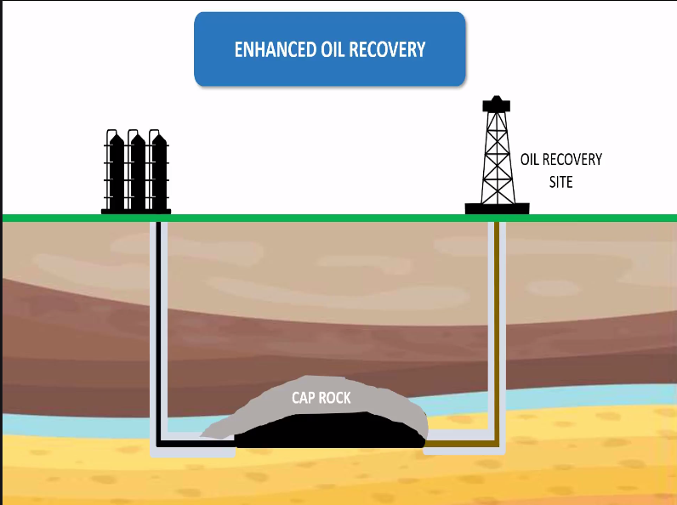
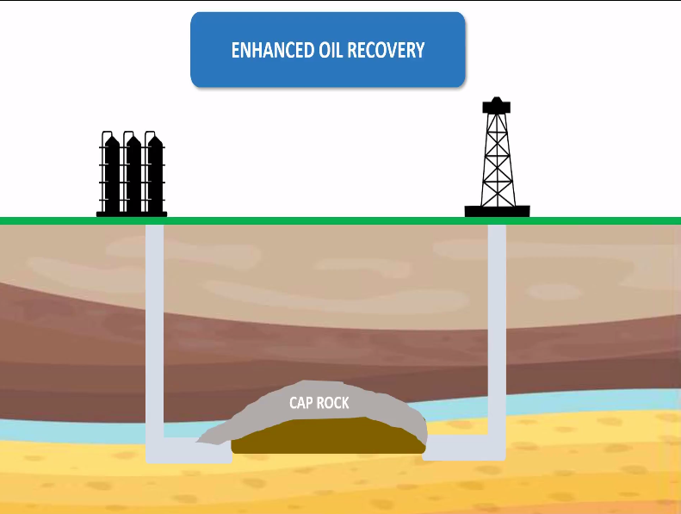

Slide 23
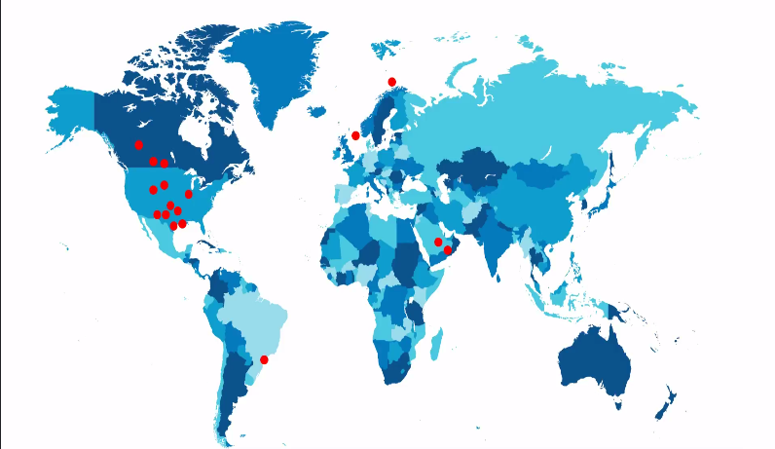

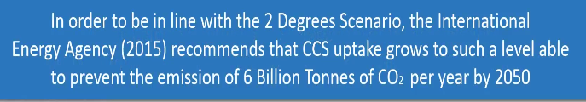

Slide 24
Barriers to the growth of CCS
Potential leakages
Local public opposition
High cost

Slide 25
The way forward to promote CCS
Competitive carbon markets
Strategic identification of storage sites
Educating the general public

Slide 26
THE END thanks for your time :)

